Slide 1
Progress meeting
01-02-2017

Slide 2
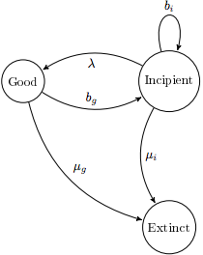
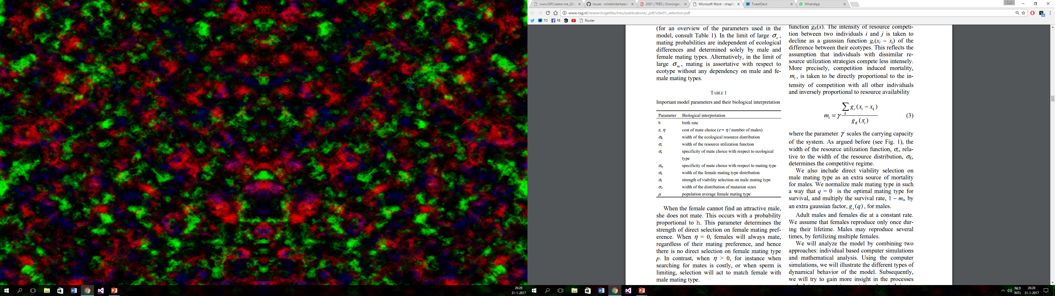
My research
Model van Doorn
Individual based
Three traits
Ecological trait
Male trait
Female preference
Protraced Birth-Death

Slide 3
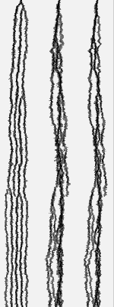
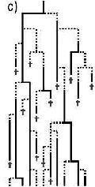
My research
Model van Doorn
Protraced Birth-Death
What are the differences?

Slide 4
My research
Model van Doorn
Protraced Birth-Death
What are the differences?

Slide 5
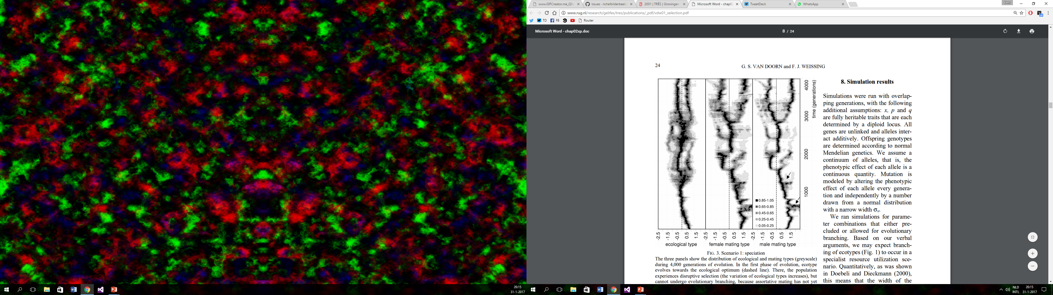
Male trait Female preference Ecological trait

Slide 6
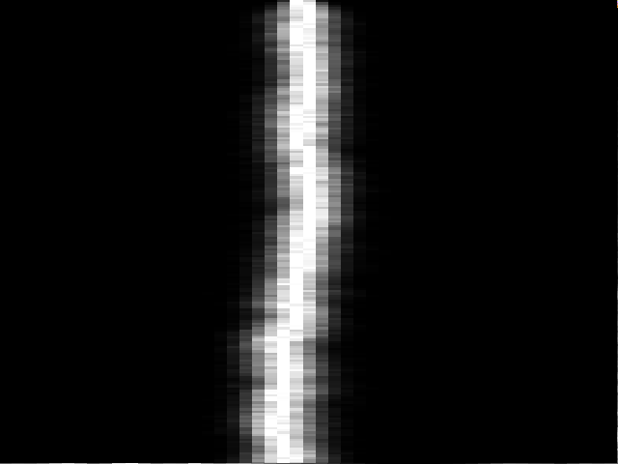
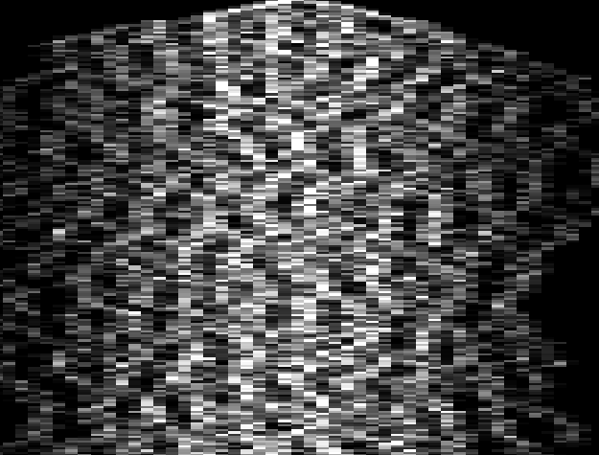
-2.5 Male trait 2.5
-2.5 female preference 2.5
-2.5 Ecological trait 2.5
4000 # generations 0
4000 # generations 0
4000 # generations 0

Slide 7
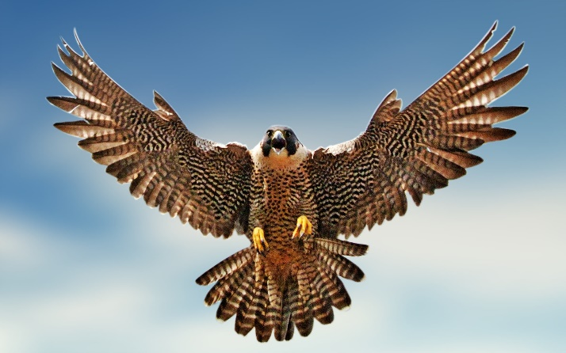
Ecological trait

Slide 8
Female preference

Slide 9
Female preference

Slide 10
Ecological trait

Slide 11
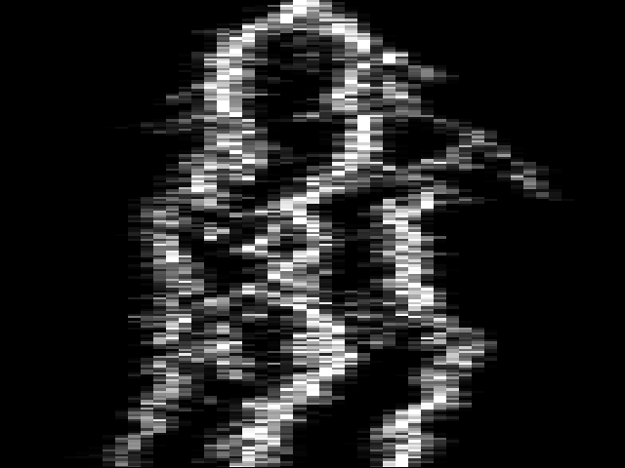
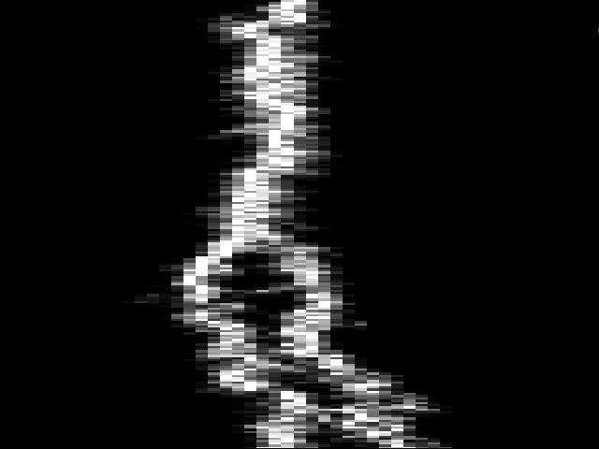
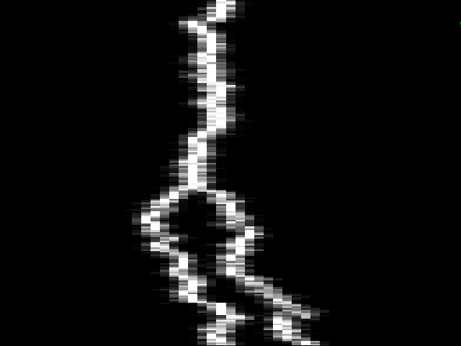
-2.5 Ecological trait 2.5
-2.5 female preference 2.5
2000 # generations 0
2000 # generations 0
-2.5 Male trait 2.5
4
1
1.2
0.6
0.5
0.2
1.0
0.02
2000 # generations 0

Slide 12
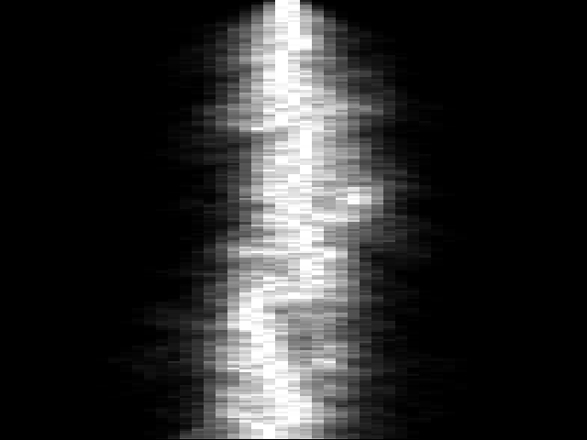
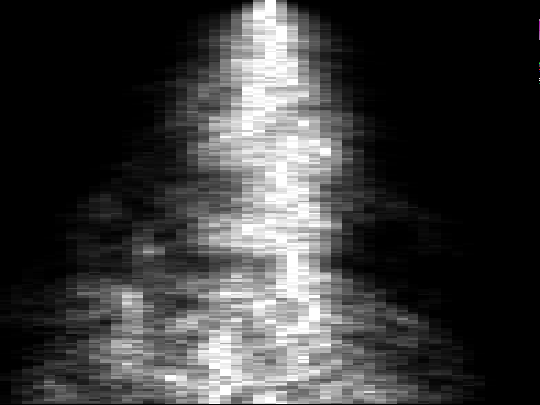
Fixed population size & separate generations
-2.5 Ecological trait 2.5
-2.5 female preference 2.5
-2.5 Male trait 2.5
4000 # generations 0
4000 # generations 0
4000 # generations 0

